Slide 1
IBM HR Analytics Employee Attrition & Performance

Slide 2
OVERVIEW
IBM, a global leader in technology and consulting, is facing challenges related to employee attrition and performance management.
Despite having extensive data on employee demographics, performance, compensation, and job satisfaction, the company lacks a comprehensive understanding of the factors driving attrition and how performance metrics correlate with employee retention.
The existing HR analytics tools and methodologies may not fully capture or analyze the complex relationships between these variables.

Slide 3
Business Understanding
IBM is a global technology and consulting firm that operates in a highly competitive and dynamic market.
Effective human capital management is critical for sustaining market leadership and meeting business objectives.
Employee attrition and performance are critical factors in determining organisational success.
High turnover rates can disrupt team dynamics, increase recruitment and training costs, and potentially limit innovation and productivity.
In contrast, retaining top performers and effectively managing employee performance can boost business growth and operational efficiency.

Slide 4
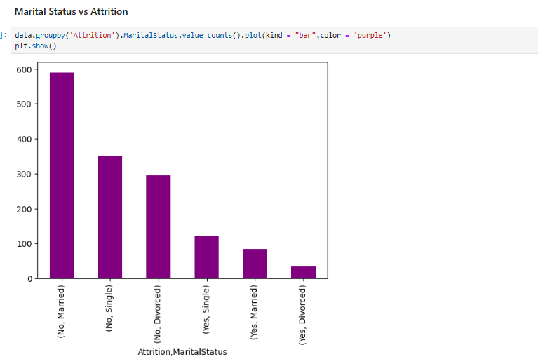
Modelling

Slide 5
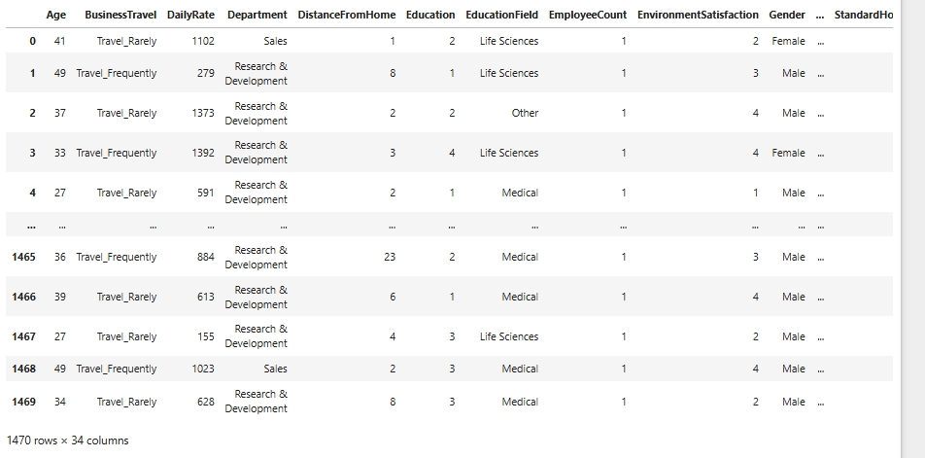
Modelling

Slide 6
Evaluation
Model | Accuracy | Precision | Recall | F1 Score
DecisionTree | 0.836735 | 0.52381 | 0.22449 | 0.314286

Slide 7
Conclusion
The Decision Tree model has a high accuracy of 83.67%, indicating that it performs well in correctly predicting both attrition and non-attrition cases overall.
With a precision of 52.38%, the model is moderately effective at identifying instances of attrition when it predicts them.
The recall of 22.45% is relatively low, indicating that the model identifies only a small fraction of actual attrition cases.
The F1 Score of 31.43% reflects a balance between precision and recall, but the low score highlights that the model struggles to effectively capture the positive cases (attrition) while maintaining a reasonable level of precision.

Slide 8
Recommendations
Improve Recall:
Focus on improving the model's recall to ensure that more actual attrition cases are identified.
Feature Engineering:
Enhance the feature set to better capture the factors contributing to attrition.
Model Enhancement:
Consider experimenting with different algorithms and hyperparameter tuning to improve the model's performance metrics.

